Slide 1
Leader Election for Ring Topology
Group Members:
Balwinder Hayer
Saytu Singh

Slide 2
Problem Statement & Motivation
-Write a program using MPI to simulate a leader election algorithm for a ring topology
-Motivation was that we wanted to learn more about ring topology use this project to use on our resume
At start on election round, each active process sends its ID to its neighbors on either side.
Send its rank to its neighbors
Receive ranks from its neighbors
If the process’s rank is the lowest of the 3, then it will set itself to passive
If the process’s neighbor’s ranks is equal to its own rank, then it will break out of loop and elect itself LEADER.

Slide 3
Programming Languages Used
MPIC++
C Compiler

Slide 4



MPI Commands Used
We have used following list of MPI commands in our project:
MPI_Init()
MPI_Comm_size()
MPI_Comm_rank()
MPI_Comm_World
MPI_Send()
MPI_Recv()
MPI_Barrier()
MPI_Abort()
MPI_Finalize()

Slide 5
Technical Difficulties Encountered
We face difficulty formatting output from multiple processes
Cross-platform issues (different outcomes)

Slide 6
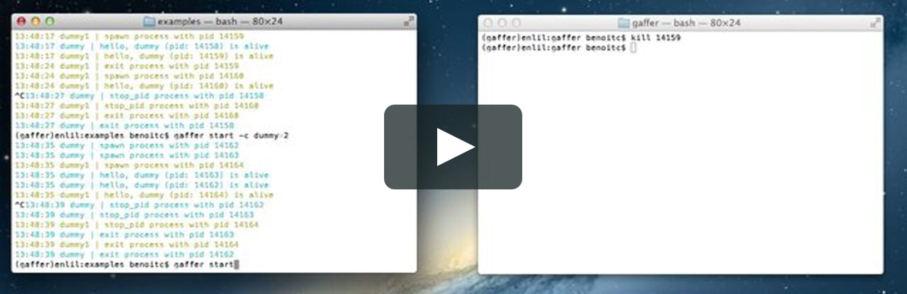
DEMO

Slide 7
Shortcomings
Processes were not terminating due to using blocking communication
Solution: used non-blocking communication(MPI_Isend, MPI_Irecv)

